Slide 1
Parallelization of Full-Field Reorientation in Microstructure Evolution
Group 20
314553031 賴均 314581003 林奇毅 314551115 楊淳嵋

Slide 2
Outline
Introduction
Motivation
Problem Statement
Methodology and Challenges
Experiment and Evalution
Conclusion
Contribution

Slide 3
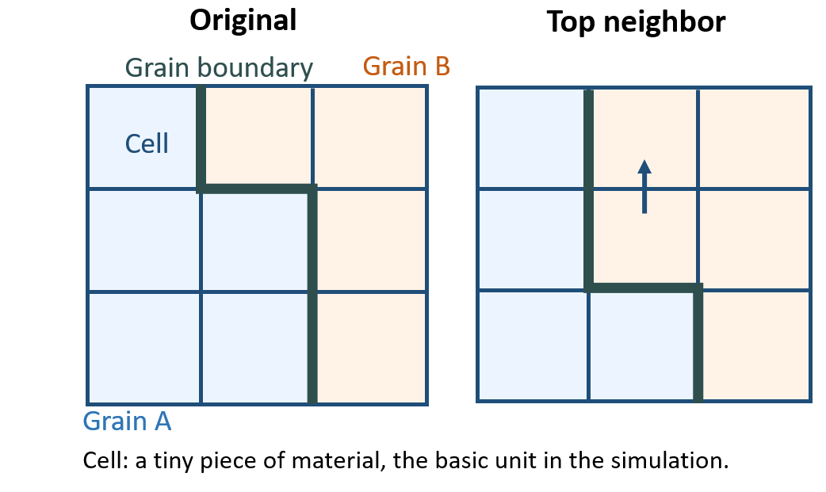
Introduction
CA-based recrystallization model. for each simulation step:
Scanning: Identify interface cell.
Energy computation: For each interface cell, evaluate ΔE to all neighbours.
State update: Each cell takes the neighbour with the largest energy drop, defining the local boundary motion.
Notes:
用 CA 來模擬晶粒成長 / 再結晶的演化

Slide 4
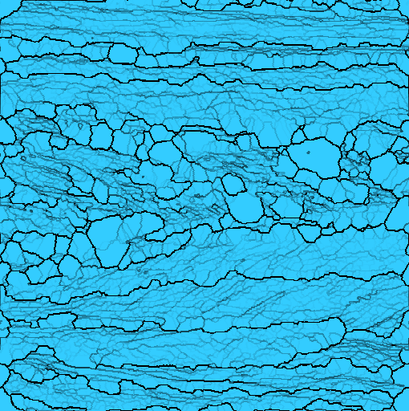
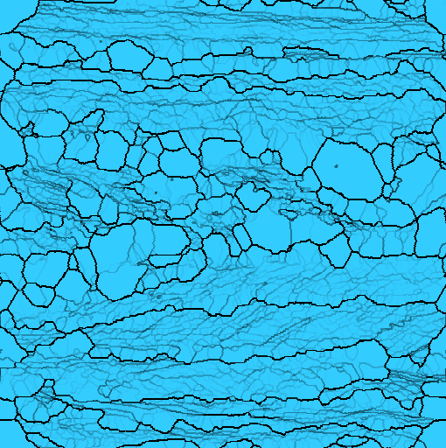
Motivation and Observation
Overcoming performance bottlenecks and improve scalability
Main bottleneck: Energy computation+State update accounts for ≈ 87% of the total runtime. (perf)
This kernel is naturally parallel:
Independent updates per interface cell
Minimal global state
→
Over an hour of CPU time for only 2 seconds of physical time

Slide 5
Problem statement
Data Structure Constraint
Interface cell indices are stored in a std::set<int> for fast updates and deduplication.
However, std::set<int> only provides bidirectional iterators, which makes it hard to partition interface cells evenly across threads.
Serialization Bottleneck
The current kernel is purely serial, so our goal is to parallelize it so that multiple cores each process a subset of the interface indices.

Slide 6
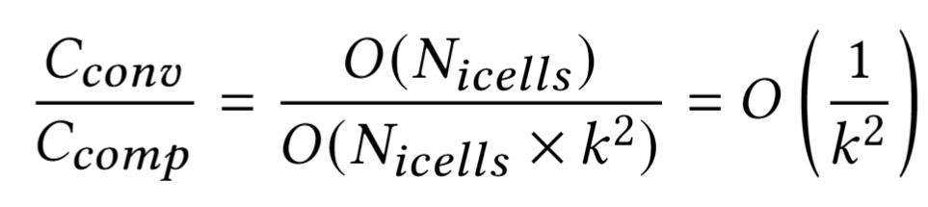
Methodology
Data Structure Conversion (for OpenMP)
Keep std::set<int> for updates, but before the kernel flatten it into a std::vector<int>
The copying overhead is negligible:

Slide 7
Methodology
Data-Level Parallelism and Multiple Backends
Method | Role | Reasoning
OpenMP | Primary | Easy to integrate with the existing C++ codebase; low development cost.
Pthreads | Baseline | A low-level CPU implementation to understand raw threading overhead and serve as a baseline for OpenMP.
CUDA | Exploration | A GPU version to offload massive parallel calculations and explore the maximum achievable speedup.

Slide 8
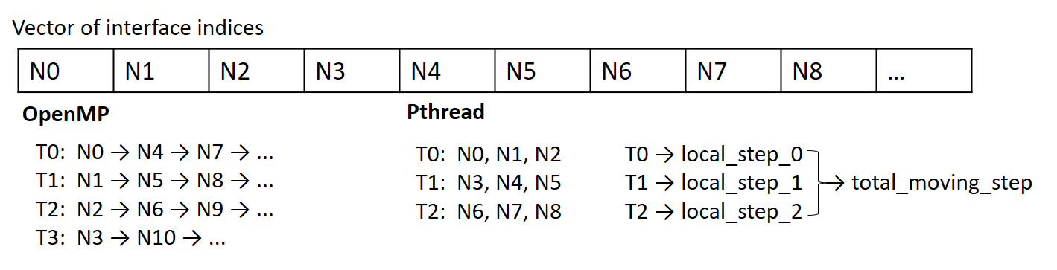
Methodology
Interface-index level parallelization.
OpenMP
Global accumulators use reduction to avoid data races.
Theoretically, the workload for each interface cell might vary →dynamic scheduling
Pthread
Each thread keeps a local counter and we sum them at the end
Threads was performed manually using a static block partitioning approach

Slide 9
Methodology- CUDA
Thread-per-cell model.
GPU scheduler automatically packs threads into blocks and warps

Slide 10
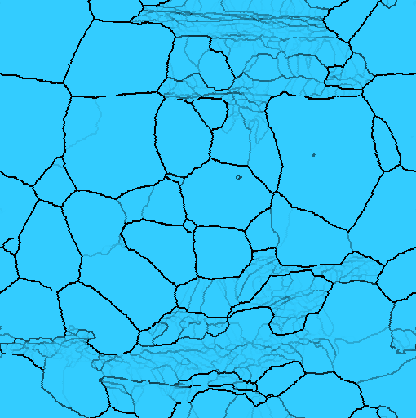
Other Challenges
Parallelization Overhead and Trade-off:
Problem: Late steps with small 𝑁icells have relatively higher parallization overhead.
Solution 1: Ignore. Total runtime is dominated by early–mid stages, so disabling parallization yields only minor gains.
Solution 2: Disable parallization for tiny Nicells.

Slide 11
Experiment
CPU Platform (Serial & OpenMP)
Intel Xeon E5-2650 v3 (20 vCPUs, 32 GB DDR4)
Debian 12, g++ 12.2.0
GPU Platform (CUDA)
NVIDIA Tesla T4 (16 GB GDDR6)
Google Colab, nvcc
Dataset
Case: 80CR2, hexagonal 2D grid
Input size: from 50×50 up to 510×592 (full-size grid)
Notes:
因為工作站的CUDA驅動版本太舊不支援編譯器的版本，所以我們改成在colab 上面用T4 GPU來測試

Slide 12
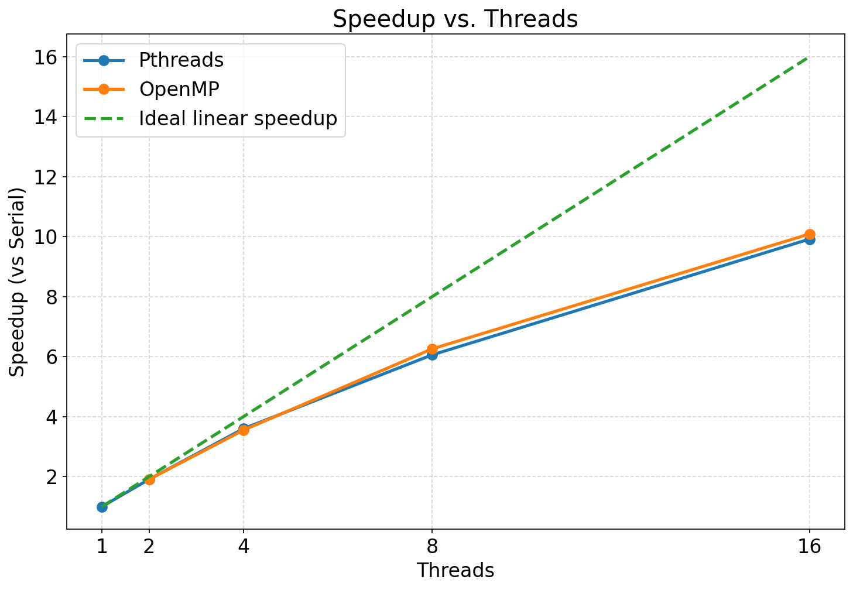
Evalution: Pthread & OpenMP
Thread scalability:
meet the expectation:
>5× at 8 threads
2–4: near-linear
→ 5–16: flat (memory-bound)
Pthreads and OpenMP perform similarly.

Slide 13
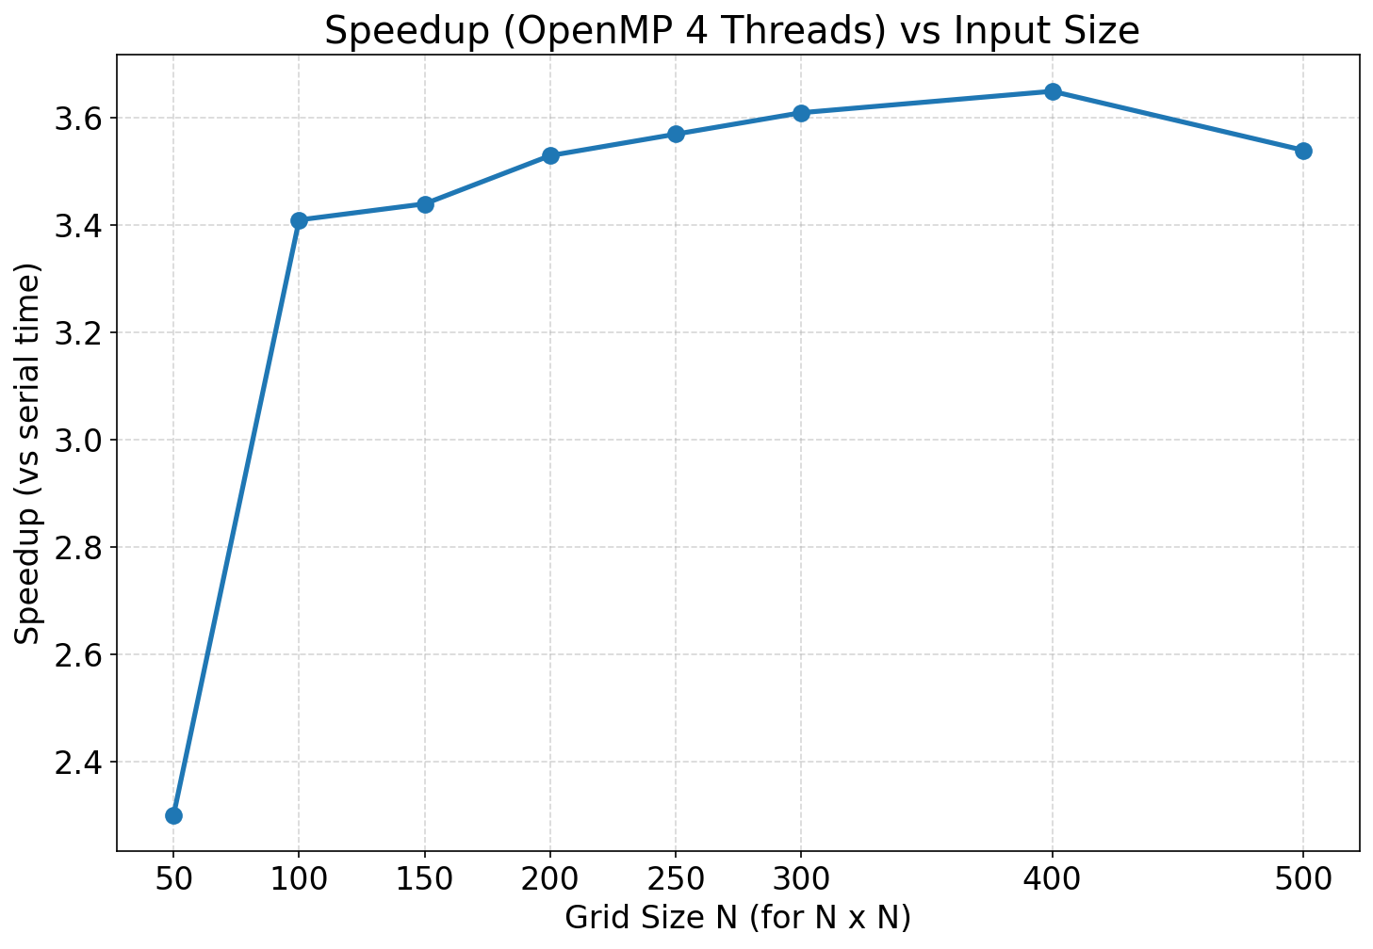
Evalution: OpenMP
Data size scalability:
Parallelization overhead → Sweet spot → Memory-bandwidth limit

Slide 14
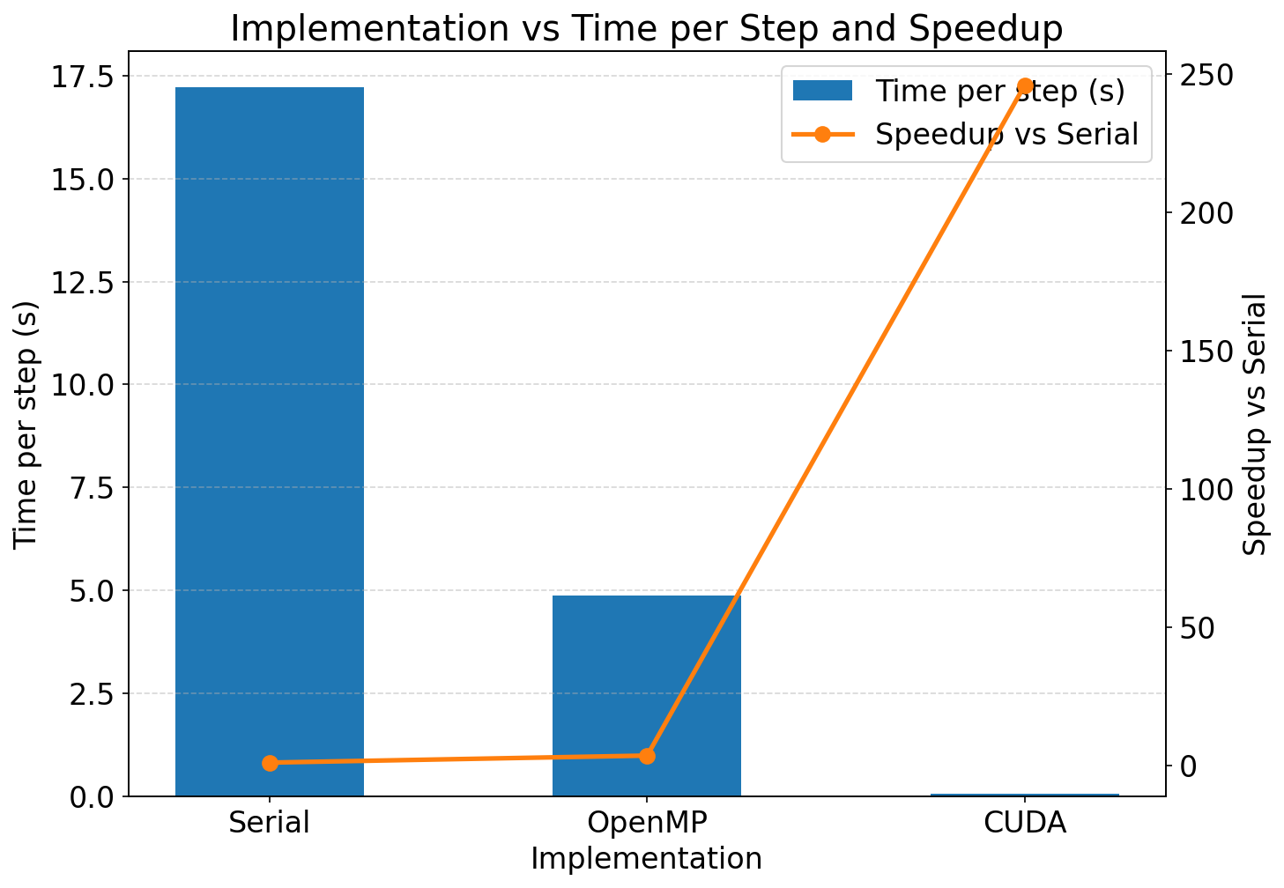
Evalution: CUDA
Data size scalability:
Full size input.
Thousands of lightweight GPU threads and high bandwidth GDDR for neighbor lookups
→ up to 246× speedup.
Notes:
CUDA也要測不同INPUT SIZE嗎

Slide 15
Conclusion
We successfully parallelized the CA microstructure simulator using OpenMP, Pthreads, and CUDA.
Performance: >5× speedup on an 8-core CPU, with scalability across input size and thread count; up to 246× per step on the GPU

Slide 16
Contribution
314553031 賴均
proposal, implementation, analysis, presentation
314581003 林奇毅
proposal, implementation, analysis, presentation
314551115 楊淳嵋
proposal, implementation, analysis, presentation

Slide 17
Thank you!

